Slide 1
Welcome to Deathwatch
All images, concepts and descriptions herein belong to Games Workshop, Fantasy Flight games and the Emperor of Mankind.

Slide 2
How did you get here?
From your Chapter’s Seed planet, you were chosen
You were tested in combat.

Slide 3
How did you get here?
Once accepted into your Chapter, you were…Enhanced…
Secondary Heart
Ossmodula
Biscopea
Haemastamen
Larramans Organ
Catalepsean Node
Premnor
Omophagea
Multi-Lung
Occulobe
Lyman’s Ear
Sus-an Membrane
Melanchromic Organ
Oolitic Kidney
Neuroglottis
Mucranoid
Betcher’s Gland
Progenoids
Black Carapace

Slide 4
How Did you Get Here?
You were trained in a number of skills and conditioned with the most valuable talents.
You were provided the finest equipment.

Slide 5
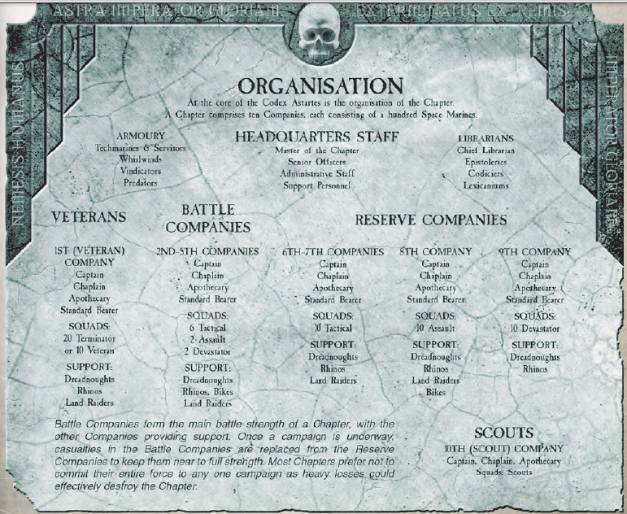
You moved up in the ranks of your chapter.

Slide 6
You have earned the honor of Deathwatch!

Slide 7
Why are you here?
1st through 25th millennia – Mankind moves out from terra to colonize the galaxy.
25th through 30th millennia- Warp storms stop interstellar travel. Mutations increase, mankind enters and age of anarchy and despair.

Slide 8
Why are you Here?
In the 30th Millennium, the immortal and benevolent emperor of mankind re-unites the galaxy in the Great Crusade.

Slide 9
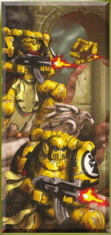
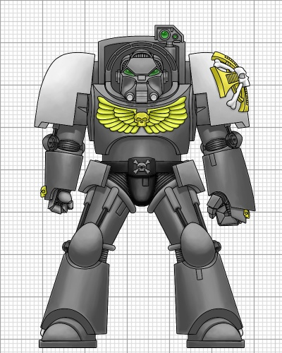
Why are you Here?
During the first founding the emperor creates the Space Marine Chapters, instilling each Primarch with part of his own being.

Slide 10
Why are you here?
Warmaster Horus goes bad.
A civil war breaks out that almost destroys the Imperium.

Slide 11
Why are you Here?

Slide 12
Why are you Here?
Today, the beloved emperor lives in stasis on holy terra.
Many threats exist to the empire.
The duty of the Deathwatch is to stand vigilant against the Xenos threat.

Slide 13
The Jericho Reach

Slide 14
The Warp Gate
A wormhole connecting the Jericho Reach with the other side of the galaxy.

Slide 15
Watch Fortress Erioch
A massive Deathwatch Fortress, floating in the Erioch System.
Center for Deathwatch activity in the Jericho Reach

Slide 16
Watch Fortress Erioch
Mogrial
Omega Vault

Slide 17
The Jericho Reach

Slide 18
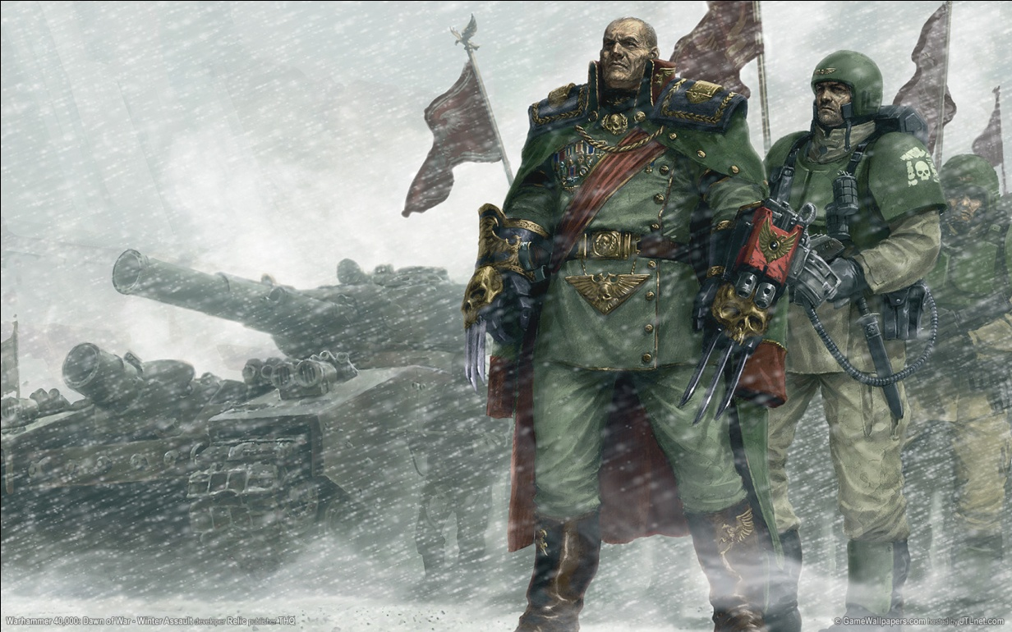
The Archilus Crusade

Slide 19
The Orpheus Salient

Slide 20
The Acheros Salient

Slide 21
The Canis Salient

